Slide 1
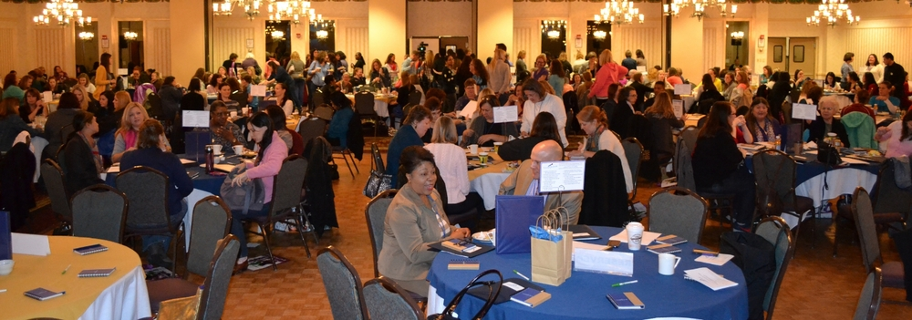
It’s time to register for …
Save the Date for…
for educators and parents!
Saturday, November 11, 2017 – 8 am to 4 pm
CLARION inn, Frederick, md
The TFS conference provides practical strategies for educating
students with Down syndrome and other special needs.
The format for 2017 includes a keynote and breakout sessions,
and combines educators and parents for a full-day conference!
Who should attend? General educators, special educators, paraeducators, administrators, counselors, therapists, and parents. Topics addressed are relevant for students from preschool through high school level.
Cost: Only $25 including:
Continental breakfast, deli lunch buffet, and snacks.
Continuing education credit for some teachers and therapists. (See website for details.)
Exhibitors with resources for educators and parents.
Free raffle and door prizes. (Must be present to win, and prizes are not redeemable for cash.)
Registration: Registration will open in early September 2017 at www.techniquesforsuccess.org

